Slide 1
CS35L Software Construction Laboratory Week 6 Lecture 1

Slide 2
System Call Programming and Debugging

Slide 3
Kernel
kernel is the core of the OS
interface between hardware and software
controls access to system resources: memory, I/O, CPU
Manages CPU resources, memory resources, processes
Lowest layer above the CPU
ensure protection and fair allocations

Slide 4
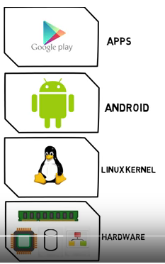
An example: Android OS

Slide 5
Modes
Operating modes that place restrictions on the type of operations that can be performed by running processes
User mode: restricted access to system resources
Kernel/Supervisor mode: unrestricted access
User
Process
User Space
Supervisor
Process
Supervisor Space

Slide 6
User Mode vs. Kernel Mode
These are the two modes in which a program executes
Hardware contains a mode-bit, e.g. 0 means kernel mode, 1 means user mode
User mode
CPU restricted to unprivileged instructions and a specified area of memory
Less privileged
Exception will crash single process
Kernel mode
CPU is unrestricted, can use all instructions, access all areas of memory and take over the CPU anytime
High privilege
Exception will crash the entire OS

Slide 7
User space v/s Kernel Space
User space - where normal user processes run
limited access to system resources: memory, I/O, CPU
Kernel space
stores the code of the kernel, which manages processes
prevent processes messing with each other and the machine
only the kernel code is trusted

Slide 8
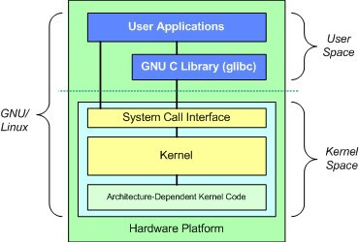
Which Code is Trusted?
=> The Kernel ONLY
•
Core of OS software executing in supervisor state
Trusted software:
•
–
Manages hardware resources (CPU, Memory and I/O)
Implements protection mechanisms that could not be changed through actions of untrusted software in user space
–
Image by: Tim Jones (IBM)

Slide 9
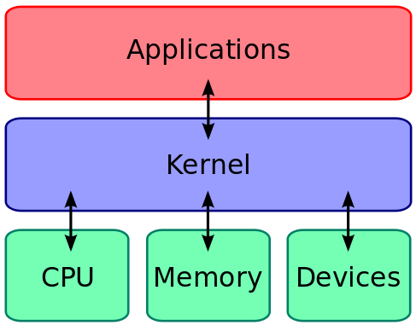
What About User Processes?
The kernel executes privileged operations on behalf of untrusted user processes

Slide 10
System Calls
Special type of function that:
Provide interface between user programs and OS
Used by user-level processes to request a service from the kernel
Changes the CPU’s mode from user mode to kernel mode to enable more capabilities
Is part of the kernel of the OS
Verifies that the user should be allowed to do the requested action and then does the action (kernel performs the operation on behalf of the user)
Is the only way a user program can perform privileged operations

Slide 11
User Programs
Kernel
Hardware Resources
System Call

Slide 12
System Calls
When a system call is made, the program being executed is interrupted and control is passed to the kernel
If operation is valid the kernel performs it

Slide 13
System Call Overhead
System calls are expensive and can hurt performance
The system must do many things
Process is interrupted & computer saves its state
OS takes control of CPU & verifies validity of op.
OS performs requested action
OS restores saved context, switches to user mode
OS gives control of the CPU back to user process

Slide 14
What actually happens?
System call generates an interrupt
OS gains control of the CPU
OS finds out the type of system call
OS creates the corresponding interrupt handler
Routine is executed with this interrupt handler

Slide 15
Making a System Call
System calls are directly available and used in high level languages like c and C++
Hence, easy to use system calls in programs
For a programmer, system calls are same as calling a procedure or function
So, what is the difference between a system call and a normal function?
System call enters a kernel
Normal function does not and cannot!

Slide 16
Making a System Call
App developers do not have direct access to system calls
They have to invoke the API
The functions in the API invoke the actual system calls
Advantages:
Portability: as long as a system supports an API, any program using that API can compile and run
Ease of Use: using API is significantly easier than the actual system call

Slide 17
Types of System Calls
5 categories:
Process Control
A running program needs to be able to stop execution
Normally or abnormally
If abnormally, dump of memory is created and taken for examination by a debugger
File Management
To perform operations on files
Create, delete, read, write, reposition, close
Many a times, OS provides an API to make these system calls

Slide 18
Types of System Calls
Device Management
Process usually requires several resources to execute
If available, access granted
Resources = devices
Eg: physical I/O devices attached
Information Management
To transfer information between user program and OS
Eg: time, date
Communication
Interprocess communication
Message passing model
Shared memory model

Slide 19
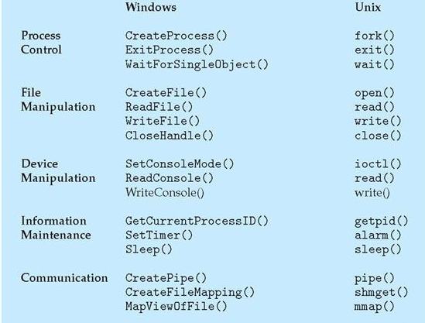

Slide 20
Executing a System Call
Follows a sequence of steps
There is a need to pass various parameters of system call to the OS
Three methods:
Register method: parameters are stored in the registers of the CPU
If size of parameters are huge, a block of memory is used. Address of that block is stored in Registers
Stack Method (in memory): parameters are pushed in the stack and OS pops it out
These are later saved in the processor registers
OS checks the system call code and creates the interrupt handler
Control is passed to the interrupt handler

Slide 21
Interrupt handler
Also known as an interrupt service routine or ISR, is a callback function in microcontroller firmware, an operating system, or a device driver whose execution is triggered by the reception of an interrupt.
It handles the request and sends it to the CPU, interrupting the active process.

Slide 22
What if there were no System Calls?
Kernel can be accessed by anyone!
Threat to the security of OS

Slide 23
Example System Calls
#include <fcntl.h>
#include <sys/stat.h>
#include <unistd.h>
int open(const char *pathname,
int close(int fd);
File descriptors
int flags, mode_t
mode);
–
–
–
0 stdin
stdout
stderr
ssize_t read(int fildes, void *buf, size_t nbyte)
•
–
–
–
fildes: file descriptor buf: buffer to write to
nbyte: number of bytes to read
•
ssize_t write(int fildes, const void
*buf, size_t nbyte);
fildes: file descriptor
buf: buffer to write from
nbyte: number of bytes to write
Notes:
ssize_t: This data type is used to represent the sizes of blocks that can be read or written in a single operation. Ssize_t is signed while size_t is unsigned

Slide 24
Example System Calls
#include <sys/stat.h>
int fstat(int filedes, struct stat *buf)
Returns information about the file with the descriptor filedes into buf
struct stat { dev_t
ino_t mode_t nlink_t uid_t gid_t dev_t off_t
st_dev; st_ino; st_mode; st_nlink; st_uid; st_gid; st_rdev; st_size;
/* ID of device containing file */
/* inode number */
/* protection */
/* number of hard links */
/* user ID of owner */
/* group ID of owner */
/* device ID (if special file) */
/* total size, in bytes */
blksize_t st_blksize; /* blocksize for file system I/O */
blkcnt_t
time_t time_t time_t
st_blocks;
st_atime; st_mtime; st_ctime;
/* number of 512B blocks allocated */
/* time of last access */
/* time of last modification */
/* time of last status change */
};

Slide 25
Library Functions
Functions that are a part of standard C library
To avoid system call overhead use equivalent library functions
getchar, putchar vs. read, write (for standard I/O)
fopen, fclose vs. open, close (for file I/O), etc.
How do these functions perform privileged operations?
They make system calls

Slide 26
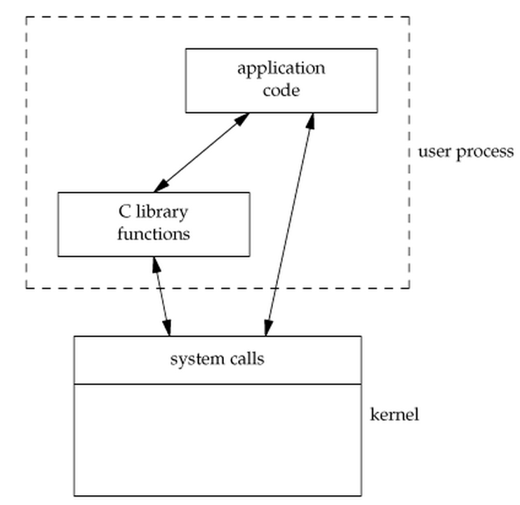
So What’s the Point?
Many library functions invoke system calls indirectly
So why use library calls?
Usually equivalent library functions make fewer system calls
non-frequent switches from user mode to kernel mode => less overhead

Slide 27
Unbuffered vs. Buffered I/O
Unbuffered
Every byte is read/written by the kernel through a system call
Buffered
collect as many bytes as possible (in a buffer) and read more than a single byte (into buffer) at a time and use one system call for a block of bytes
=> Buffered I/O decreases the number of read/write system calls and the corresponding overhead

Slide 28
Case Study: Why fopen Is Better Than open
fopen provides you with buffered I/O while open is unbuffered I/O
Every byte is read/written by the kernel through a system call in unbuffered I/O while buffered I/O collect as many bytes as possible (in a buffer) and read more than a single byte (into buffer) at a time and use one system call for a block of bytes
fopen returns FILE struct which can also be used by other stdio functions like fscanf()
fopen can work across platforms (fopen can work on platforms that does not use open, e.g., some old versions of C)
Notes:
Buffered I/O decreases the number of read/write system calls and the corresponding overhead

